Slide 1
Residential Market Advisory Group Q1 2023 Meeting
Single Family Residential
Wednesday 03/15/2023
02:00 pm – 03:30 pm ET

Slide 2
Meeting Agenda
(02:00 pm – 02:05 pm) Welcome, Agenda Review, Introductions
(02:05 pm – 02:10 pm) Opening Statement – Emily Dean
(02:10 pm – 02:30 pm) RMAG Updates – Laura Geel
(02:30 pm – 02:50 pm) NYSERDA Policy and Program Update – Courtney Moriarta
(02:50 pm – 03:20 pm) Inflation Reduction Act – Mark Dyen
(03:20 pm – 03:30 pm) Preliminary Priority Setting Session and Closeout

Slide 3
Housekeeping and Meeting Rules
This meeting will be recorded. Recording will not be for distribution and participation will not be attributed.
To participate please use the Q&A function on the right side of your screen
If you are having technical difficulties, please chat Collin Buchanan (K&W) or email at cbuchanan@kearnswest.com
Notes will be taken, and a meeting summary will be published on the RMAG website.

Slide 4
The RMAG is a forum for stakeholder engagement on the residential market’s highest priority issues
Events
Quarterly Meetings (In-Person and Virtual)
Working Groups
Expert Panels
Listening Sessions
Functions
Advance residential clean energy and efficiency market development and innovation
Iterate on programmatic design and implementation with stakeholder feedback
Provide policy updates and relevant knowledge sharing for residential actors
Foster NYSERDA clean energy and energy efficiency thought leadership

Slide 5
Attendees on today’s webinar represent a variety of sub-sectors across the clean energy market
Community Based Organizations
Contractors
Distributors
Government (Regulators, Policymakers, and Staff)
Implementation Contractors
Manufacturers
Modeling Vendors
Research Firms
Technology Firms (Software and Hardware)
Utilities
Energy Services Consultants

Slide 6
Icebreaker – Poll Everywhere
BY COMPUTER
Go to
www.pollev.com/kpoll267 on your internet browser.
BY SMART PHONE
Go to
www.pollev.com/kpoll267 on your internet browser.
BY TEXT MESSAGE
Text
kpoll267 to 22333
on your mobile device

Slide 7
Notes:
Poll Title: Do not modify the notes in this section to avoid tampering with the Poll Everywhere activity. More info at polleverywhere.com/support What is your business goal or aspiration for 2023? https://www.polleverywhere.com/free_text_polls/YEGAQCiUT04w2pSmNjSxS

Slide 8
Opening Statements
Emily Dean – Director, Housing Decarbonization

Slide 9
Residential Market Advisory Group Updates
Laura Geel - Assistant Director, Single Family Residential

Slide 10
Residential Market Advisory Group Objectives
Maintain market awareness of public policies driving investments in energy efficiency and clean energy in the residential market.
Share information on current and planned activities to enable coordination and avoid unproductive duplication of efforts in advancing progress towards policy and industry objectives.
Discuss opportunities and challenges associated with wide-scale deployment of energy efficiency and clean energy services for the residential sector and seek solutions to overcome market barriers.
Help guide the direction of the market’s existing and future clean energy solutions.
Make connections and develop collaborations among participants and partners to meet mutual objectives.
Develop and coordinate shared messaging and outreach strategies where appropriate.
Notes:
Talking points – Reference text on slide

Slide 11
Priority Setting Process
The priority setting process is done annually by the RMAG members – That’s you!
Priorities reflect areas that the membership feels are needed to meet New York State’s climate goals in residential homes and that meet the objectives of the RMAG.
Work is led by RMAG members and completed in a variety of ways – Working groups, workshops, listening sessions, information sharing, networking and matchmaking, etc.
Notes:
Talking points:
-Everyone on today’s call is part of the process as is part of the advisory group. Each person contributes in their own way – whether you spearhead a working group, participate in a breakout discussion, respond to polls, or are just a listener, your participation matters.
-We set priorities not by what NYSERDA wants the RMAG to be, but by what the members want to get out of this. We emphasize on objectives focusing on collaboration, sharing, and coordination amount the residential energy efficiency and clan energy industry.
-On an annual basis, the RMAG membership will work to identify areas that should be addressed by the group and discuss the best way for that to happen. The next few slides explain what our priorities have been over the past 2 years in the RMAG. We have accomplished a lot together and now it is time to start planning for our future work as a group. The goals for 2021-2022 fell within three themes and I’m going to go through the activities fairly quickly. We have details on specific outcomes on NYSERDA’s RMAG webpage.
During today’s meeting, you’ll hear about the current state of New York State and Federal policies and goals that impact the residential energy efficiency and clean energy market. This can help us to focus on priorities for this year, which we will spend time on at the end of this meeting.

Slide 12
2021-2022 Priorities
Theme: Normalizing Heat Pumps
Trade ally network
Experiential demonstrations
Technician trainings
Community connections
Testimonials from customers
Visible spokesperson
Notes:
. The first was around actions to normalize heat pumps. NYSERDA used the feedback from the market to develop a number of initiatives to address this – including launching Clean Heat Connect, which is a trade ally network that currently includes 5 HVAC manufacturers and 10 distributors, covering a majority of the New York State market, promoting adoption of educational and technical tools and resources through their contractor networks. 15 market interventions have been created with over 30 individual items produced including supporting and promoting heat pump sizing and design trainings in coordination with New York State Clean Heat, a coordinated online training calendar hosted on the Clean Heat Connect website, the NEEP sizing and design visualization tool, sales and technical training short videos, and more.
NYSERDA is working on experiential demonstrations which can give both technicians and customers real-life experience with heat pumps. This initiative, called Experience Clean Heat, is in development and will launch in the market with some sites to promote later this year.
Some other efforts that fit these priority areas include robust workforce development offerings, and community-based campaigns around heat pumps.
One area that we did not address is having a highly visible spokesperson or influencer run a campaign. This is something we could keep in mind for the future, and as always, look for RMAG members to help spearhead planning conversations.

Slide 13
2021-2022 Priorities
Theme: Ramping Up to Meet Our Goals
Connecting on policy goals
Seeking nontraditional partners
Customer engagement playbook
Stacked Efficiency and Electrification Pilot Framework
Workforce development forum
Notes:
A second theme was about ramping up to meet our goals. This theme is a good representation of the variety of ways we work together in the RMAG.
First, there was a desire to have more connections with policy makers and learn more about policies in the residential clean energy space. Through the RMAG, we hosted meetings with guest speakers to accomplish this.
Secondly, the RMAG sought to diversify its network by adding more companies to participate, with a special focus on nontraditional partners. Currently, there are more than 200 individuals who are part of the RMAG. We grew this list both with our own efforts, but also with all of your help spreading the word about this group. Thank you!
There was interest in sharing lessons about how best to engage with certain customer groups. We held a robust working session with RMAG members where we did a deep dive into customer engagement considerations for certain demographics.
In consideration of ramping up, there was also a desire in the group to develop a plan on how efficiency and electrification can be stacked together in a way that is replicable by programs and can result in greater impacts. Through a membership-lead working group, Stacked Energy Efficiency Program Framework was collectively developed over the course of the past year.
Lastly, one priority areas was to hold a forum to discuss workforce issues within the RMAG membership. We tried to set this up on a couple of occasions but there was not much interest to participate. And that’s OK! The members drive the priorities and the process.

Slide 14
2021-2022 Priorities
Theme: The New Normal
Lower touch engagements
Post installation data
Peer to peer groups
Standards of interoperability
Notes:
The third theme was around the New Normal, which is largely a reflection of RMAG members rethinking business operations during the covid-pandemic, and recognizing certain business operations will forever be different.
There was a strong desire to see more options for lower-touch engagement activities with building owners. NYSERDA developed the Remote Audit Challenge and we are currently working to test 6-7 virtual and remote energy assessments in the market to measure customer adoption and success in making energy efficiency and clean energy improvements. Some of this work can also lead a measurement of data after work has been done, for continuous monitoring and data collection.
There was a desire among the group to have more sharing with their peers on how to operate under “the new normal” but also ongoing peer-based discussions going forward. Our research showed there is already a number of peer to peer sharing opportunities for industry partners and during prior meetings made connections to members with organizations leading peer groups, such as the Building Performance Contractors Association.
Lastly, members expressed interest in working towards standards for inter-changeable components of clean heating equipment. After several attempts to move this conversation among the RMAG, no “champions” were identified, and this item did not progress through the RMAG. We can certainly work on this in the future if the group is interested in advancing this topic together.

Slide 15
Looking Ahead – 2023+ goals
When thinking about our priorities for NYS and the RMAG:
What does the industry look like 5 years from now? 10? 20?
What innovations need to happen to meet our goals?
What “business as usual” is OK and what needs to change?
What do we have to do less of, to achieve more?
What would you do if you needed to grow your business 10x in the next year? What would you need to be successful?
Make note of your ideas; we will gather your thoughts on priorities at the end of today’s meeting.
Notes:
As we look ahead to the work ahead of us and engage in conversations for the rest of this meeting on State and Federal work, I encourage you to think about how the industry can collaborate and where the areas of focus should be. On this slide are just some questions to get your thinking about RMAG priorities for this year and beyond. Our presenters today, Courtney and Mark, will share important information about the NYS and Federal landscape that may inspire some ideas. As I mentioned, at the end of the meeting we’ll have a poll on priorities, so please make some notes for yourself as we continue our discussion today.

Slide 16
NYSERDA Single Family Residential Policy and Program Updates
Courtney Moriarta - Director, Single Family Residential

Slide 17
Major Changes Are Here
Energy Policy Summary
NYS Department of Public Service Energy Efficiency and Building Electrification Report (CEF/NENY interim review) is underway
Climate Leadership and Community Protection Act Scoping Plan was published in January
2 Million Climate Friendly Homes Plan to be published soon
Federal Inflation Reduction Act passed in August 2022 (up to $1200/year in tax credits per home and $317M to NYS for residential rebate programs)
Empower+ and Energy Affordability Guarantee (limit household energy burden to 6% of income) in state budgeting process
Proposed NYS “cap and invest” program (30% to go to Climate Action Fund, 60% to Clean Energy Transition and Workforce)

Slide 18
Residential Incentive Opportunities
NYSERDA Program Updates
Comfort Home open enrollment started Fall ’22
Empower+ combined LMI program launching Spring ’23
Initial deployment of IRA rebates expected in late ‘23
Residential Energy Assessments, remote/virtual offer expected in early ’24
Statewide market engagement platform to be deployed in early ‘24

Slide 19
IRA Home Energy Rebate Programs
$158 Million to NYS
$159 Million to NYS

Slide 20
Timelines and What to Expect Next
Q1’23
Initial planning, due diligence for IRA programs
Q2’23
Empower+ Rollout
Q3’23
IRA program planning: final rules from DOE, final program design and submission to DOE
Q4’23
2 Million Homes Plan to be published
Improved Residential Energy Assessment Rollout
Remote Audit Challenge demonstrations in market
IRA program planning: stakeholder engagement process kicks off
CEF/NENY interim review next steps?
IRA program implementation: funding released from DOE to states, program soft launch
Planning and design for market engagement platform
Design and develop market engagement platform
Design and develop market engagement platform
IRA 25C Clean Energy and Efficiency Incentives for Individuals Tax Credits go into effect
Design and develop remote audit strategy
Q1’24
Q2’24
Deploy remote audit strategy (or Q3’24)
IRA programs full launch
Deploy market engagement platform
Q3’24
Q4’24

Slide 21
Questions?
Courtney Moriarta - Director, Single Family Residential

Slide 22
Inflation Reduction Act
Mark Dyen – Senior Consultant, Mark Dyen Consulting

Slide 23
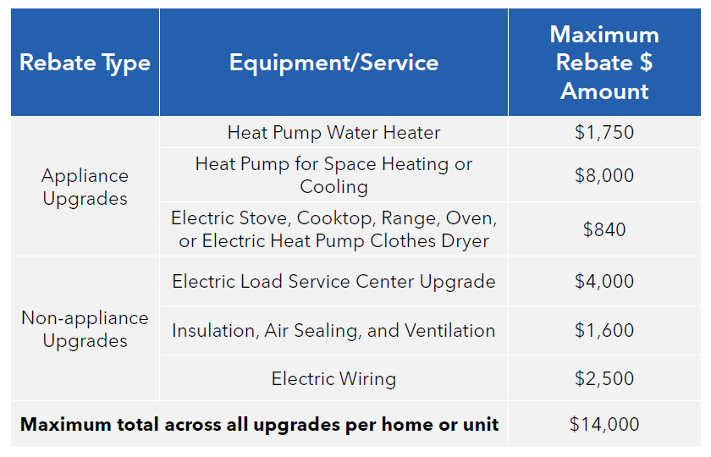
S. 50122 High Efficiency and Electrification Home Rebate Program (HEEHRA)
In addition, states may provide up to $500 toward the cost of installation to the entities who perform the installation*
Limited to households making less than 150% of median income*
HEEHRA incentives may be combined with HOMES incentives at the project/home level, but not at the measure level
*Final DOE rules and NYS program design details are TBD

Slide 24
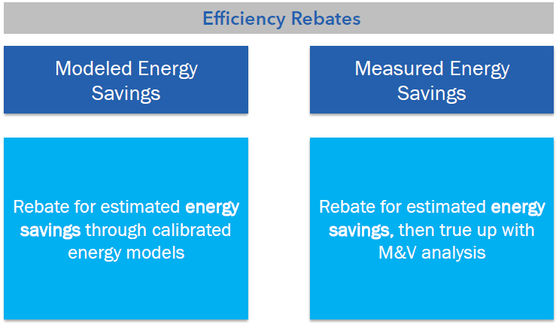
S. 50212 Home Energy Performance-Based, Whole-House Rebates (HOMES)
To use procedures, as approved by the Secretary, for determining the reductions in home energy use resulting from the implementation of a home energy efficiency retrofit that are calibrated to historical energy usage for a home consistent with BPI 2400, for purposes of modeled performance home rebates;
To use open-source advanced measurement and verification software, as approved by the Secretary, for determining and documenting the monthly and hourly (if available) weather-normalized energy use of a home before and after the implementation of a home energy efficiency retrofit, for the purposes of measured performance home rebates

Slide 26
Notes:
Poll Title: Do not modify the notes in this section to avoid tampering with the Poll Everywhere activity. More info at polleverywhere.com/support Given New York's current policy objectives to realize 2 million electrified or electrification-ready homes by 2030, what is the best use of HEEHRA rebates to help support those goals? https://www.polleverywhere.com/free_text_polls/tAEQtQ7R42o0bvIDag02x

Slide 27
Notes:
Poll Title: Do not modify the notes in this section to avoid tampering with the Poll Everywhere activity. More info at polleverywhere.com/support What are the key considerations NYSERDA should take into account when developing an implementation plan for HOMES? https://www.polleverywhere.com/free_text_polls/VQVIF6LtvqaAYtKXwxDxK

Slide 28
Notes:
Poll Title: Do not modify the notes in this section to avoid tampering with the Poll Everywhere activity. More info at polleverywhere.com/support NYSERDA is assessing a variety of approaches to satisfy the modeling requirement of the HOMES program. What key considerations should be taken into account? https://www.polleverywhere.com/free_text_polls/vVHx8UByeLXldKIvHEWUb

Slide 29
Notes:
Poll Title: Do not modify the notes in this section to avoid tampering with the Poll Everywhere activity. More info at polleverywhere.com/support Considering many NYS homes use a combination of fuels to heat and power their homes, including non-metered fuels that utilities do not make data readily available to NYSERDA for, how should we adapt BPI-2400 to meet the HOMES modeled path requirements? https://www.polleverywhere.com/free_text_polls/VAI9L7eAOONQGp8sJ7kN1

Slide 30
Looking Ahead – 2023+ goals
When thinking about our priorities for NYS and the RMAG:
What does the industry look like 5 years from now? 10? 20?
What innovations need to happen to meet our goals?
What “business as usual” is OK and what needs to change?
What do we have to do less of, to achieve more?
What would you do if you needed to grow your business 10x in the next year? What would you need to be successful?
Make note of your ideas; we will gather your thoughts on priorities at the end of today’s meeting.
Notes:
As we look ahead to the work ahead of us and engage in conversations for the rest of this meeting on State and Federal work, I encourage you to think about how the industry can collaborate and where the areas of focus should be. On this slide are just some questions to get your thinking about RMAG priorities for this year and beyond. Our presenters today, Courtney and Mark, will share important information about the NYS and Federal landscape that may inspire some ideas. As I mentioned, at the end of the meeting we’ll have a poll on priorities, so please make some notes for yourself as we continue our discussion today.

Slide 31
Notes:
Poll Title: Do not modify the notes in this section to avoid tampering with the Poll Everywhere activity. More info at polleverywhere.com/support Based on what you have heard today, what are the highest priorities that the RMAG should focus its attention on to advance the residential market? https://www.polleverywhere.com/free_text_polls/gWJBPz3FogHQCf0RwUiwg

Slide 32
Closing and Next Steps
Action Item: Please complete a short post-meeting survey to help us set priorities in 2023 for the RMAG. A larger priorities survey will follow in the coming weeks to help further scope our activities.
Action Item: Go to https://www.nyserda.ny.gov/Partners-and-Investors/Partner-With-NYSERDA/Residential-Market-Advisory-Group to learn more about us!

